Slide 1

Central Gas Origination & Trading
2001
Enron North America
March 9, 2001

Slide 2
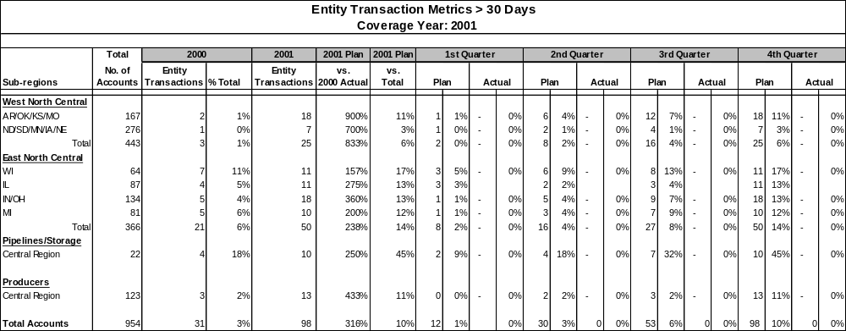
2001 Market Deliverables
Market Deliverables
  Customer Deal Flow
    Increase customer transactions
      2000: 158 > 30 Days
      2001Plan: 474 > 30 Days
      300% Growth
    Develop new customers
      2000: 35 Entity Transactions
      2001 Plan: 98 Entity Transactions
      300% Growth / 10% Market
      Increase overall volumes
        2000: 65 BCF
        2001 Plan: 160 BCF
        250% Growth
      Increase Customer Contact/Coverage
        Mid-Year / 50% EOY / 100%
*** Percentages are calculated as a percent of the total number of accounts

Slide 3
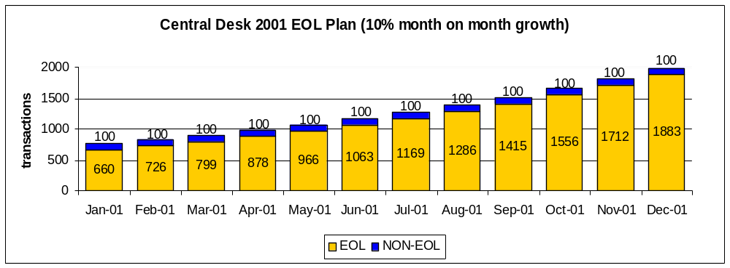
2001 Market Deliverables
  Strategic Outsourcing/Customer Asset Management
      2001 Plan: 3 Strategic Outsourcing/Asset Management
        2 Producer Specific
  EOL Specific
    Develop new customers
      Regional – 3 /Quarter
      Class – 2 Industrials, 1 ESCO, 1 IPP, 2 Producers, 6 Other
    Increase overall trades and trades per customer
      2000 EOY: 676/d
      2001 Plan EOY: 1883/d

